Slide 1
Group Project Solution
Group 10
Notes:
Maximum floor time: 30 mins

Slide 2
Team Organisation
Product Owner:
Chloe Allen
Team 1
Robin Watson (lead)
Andrew Lamnea
Sean Tomlinson
William Cooter
Team 2
Ellis Doran (lead)
Joshua Davies
Edward Joyner
Back-End
Ethan Kelly
Henry Nicholson
Notes:
During our initial build I took on the role of the client as Product Owner, so I could direct the team following the client meeting.
I then divided the teams with a larger group doing some of the potentially more difficult work, a smaller group working on the next step of the project as we discussed in the planning meetings after the client meeting.
There were also two group members I put on back-end set up.
Their role within the group was to handle the groups back-ups and Git repository, so our saved work was protected.

Slide 3
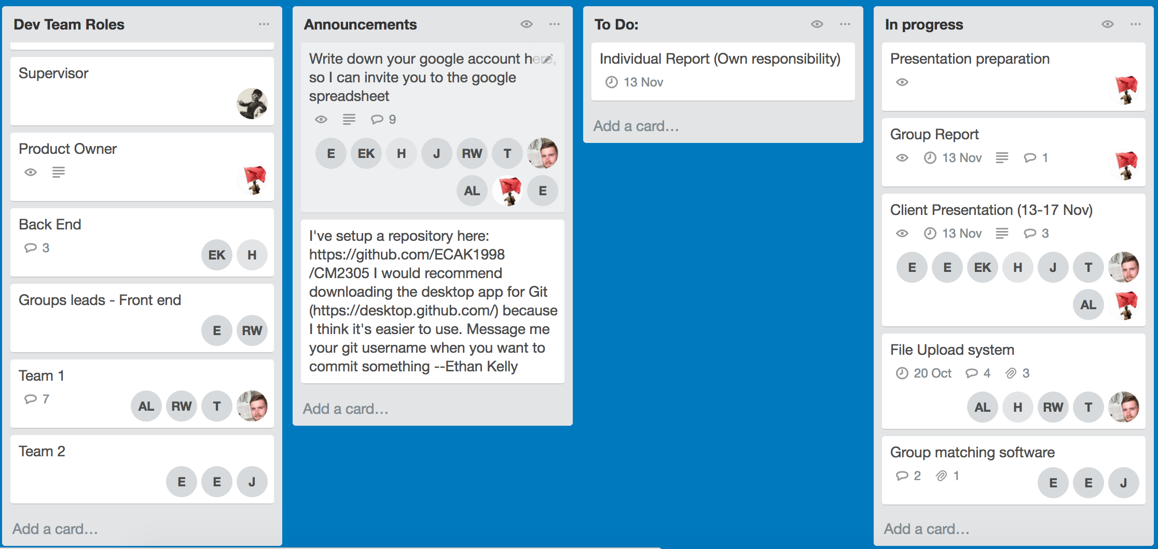
Team Management
Notes:
-Agile approach
-Main method of managing was Trello
-broke task into parts
-Flexible
-Easy to use
-Quick to deploy
-Considered for group project plugin in future

Slide 4
Initial Criteria
Full Management Tool
Blackboard Falldown
Manage people
Manage group project
Easy to add to
Communication methods
Email
Group messaging
Messaging tool
Slack plugin
Message board format
Forum style
/R/GroupProjec/

Slide 5
Initial Criteria
Handling groups by experience
Personality testing
Personality quiz
Experience testing
Grade based ✗
Quiz based
Abstract overview of skills
Fun
Emotional intelligence testing
Method of gauging personalities
Must be flexible on group members
Semi random sort
Notes:
-Quizzes based on relevant questions to the project
-Or relevant code (Java, Python, Project management)
-Clients experience was that it didn’t matter a lot if all the
-Cognitive tests, way of testing for memory, perception
-Testing for personality types through quizzes
-Fun, game or something interactive
-Abstract methods of measuring Emotional intelligence
-Opportunities to write a project for your own group
-Potentially allow groups to come up with and submit own project

Slide 6
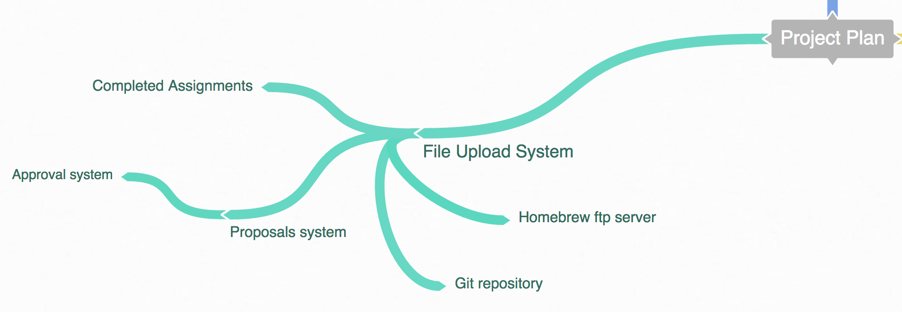
Approach
Notes:
To approach this problem I split the teams, as mentioned earlier. Then we held a meeting to discuss the possible solutions to match the problem. We split these into 4 major categories to lay the groundwork for the client.
This is the File Upload System, these are some of the ideas the team came up with.

Slide 7
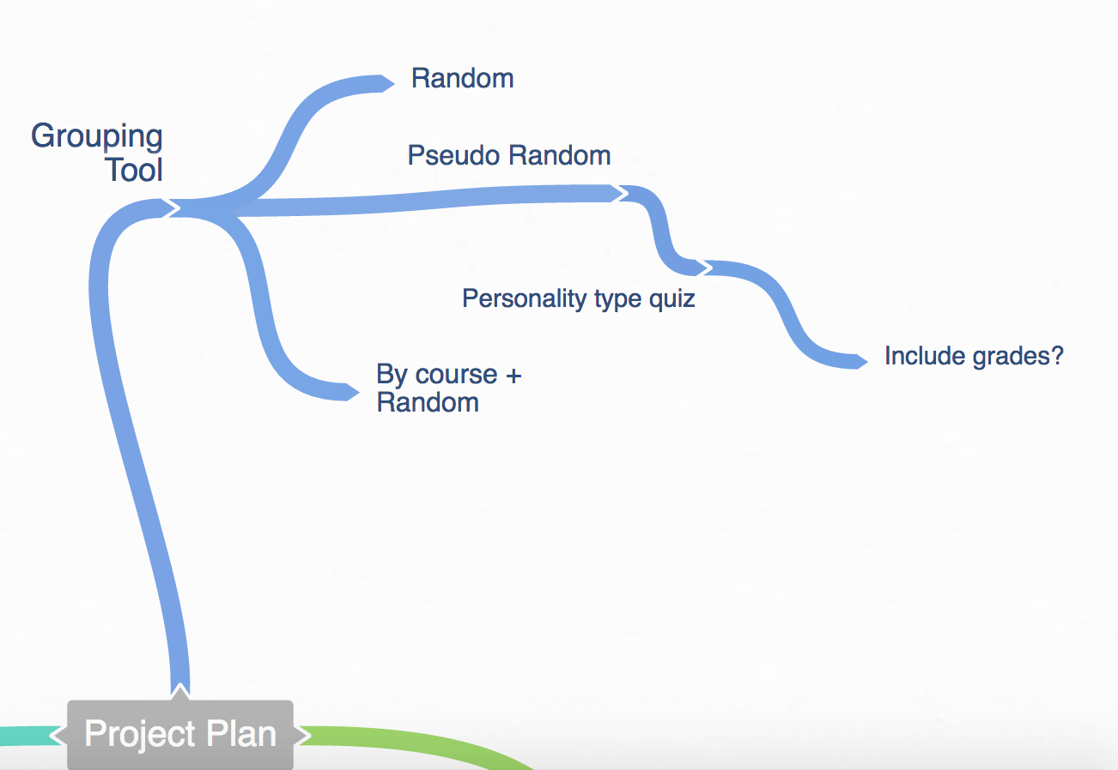
Approach
Notes:
This is the Grouping tool, this is another feature the client felt was important, so we spoke in a group meeting and felt it was best to produce a

Slide 8
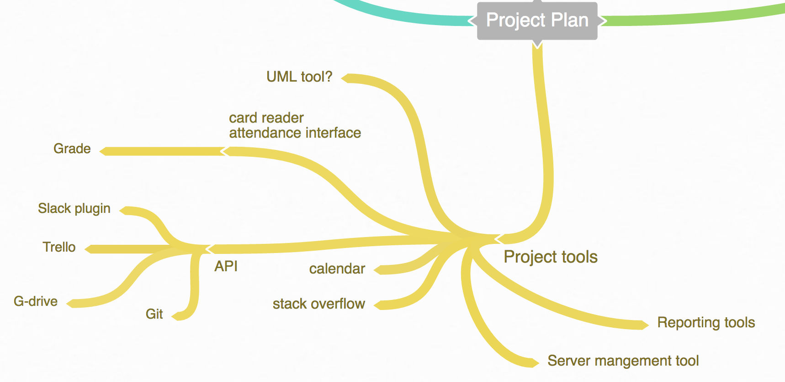
Approach
Notes:
The Project Tools thread is a little crowded but essentially includes a large selection of tools. These tools we will revisit in future iterations of the project

Slide 9
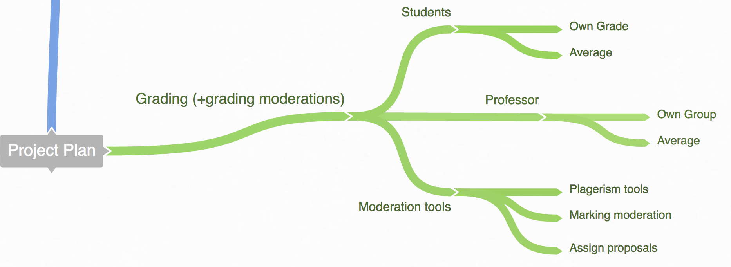
Approach
Notes:
These are the grading tools suggested for the project, they are going to be the focus of later projects.

Slide 10
Team 1 Criteria
Sub divided
2 teams

Slide 11
System Requirements

Slide 12
Team 2 Criteria

Slide 13
System Requirements

Slide 14
Legal/Social

Slide 15
Ethical/Professional

Slide 16
Summary

Slide 17
Any Questions?

